Slide 1
Food webs and beyond – ecological networks and network analysis
Gabor Pozsgai

Slide 2
Course outline
Networks in general (importance, history, mathematics)
Ecological networks (history, types, stability)
Network measures, comparing networks
Practical network analysis with R

Slide 3
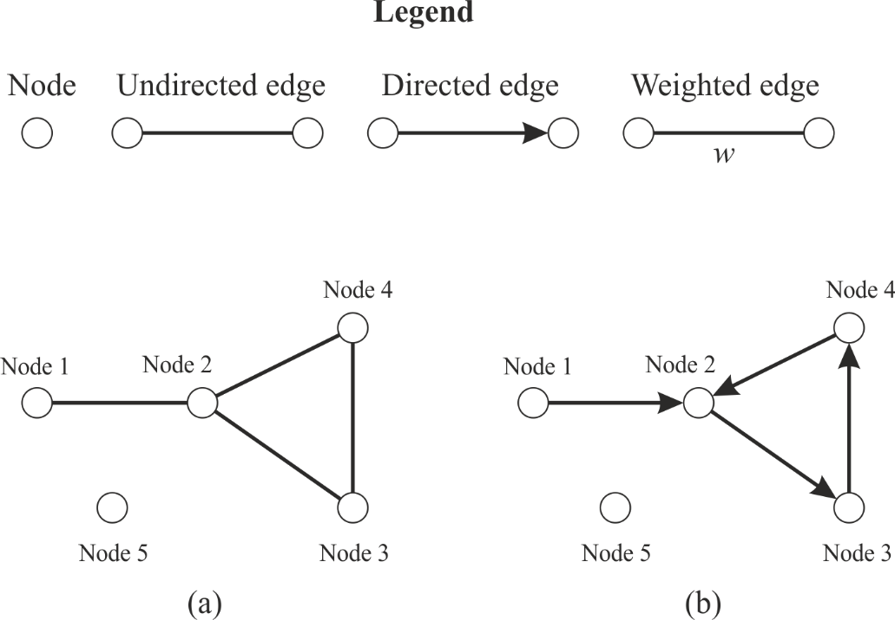
What are networks?
Networks can efficiently be represented using the mathematical formalism of graph theory.
A graph (G) is defined as an ordered pair (V, E), where every element of E (the edges) is a two-element subset of V (the nodes).
Directed or not directed
Can have loops

Slide 4

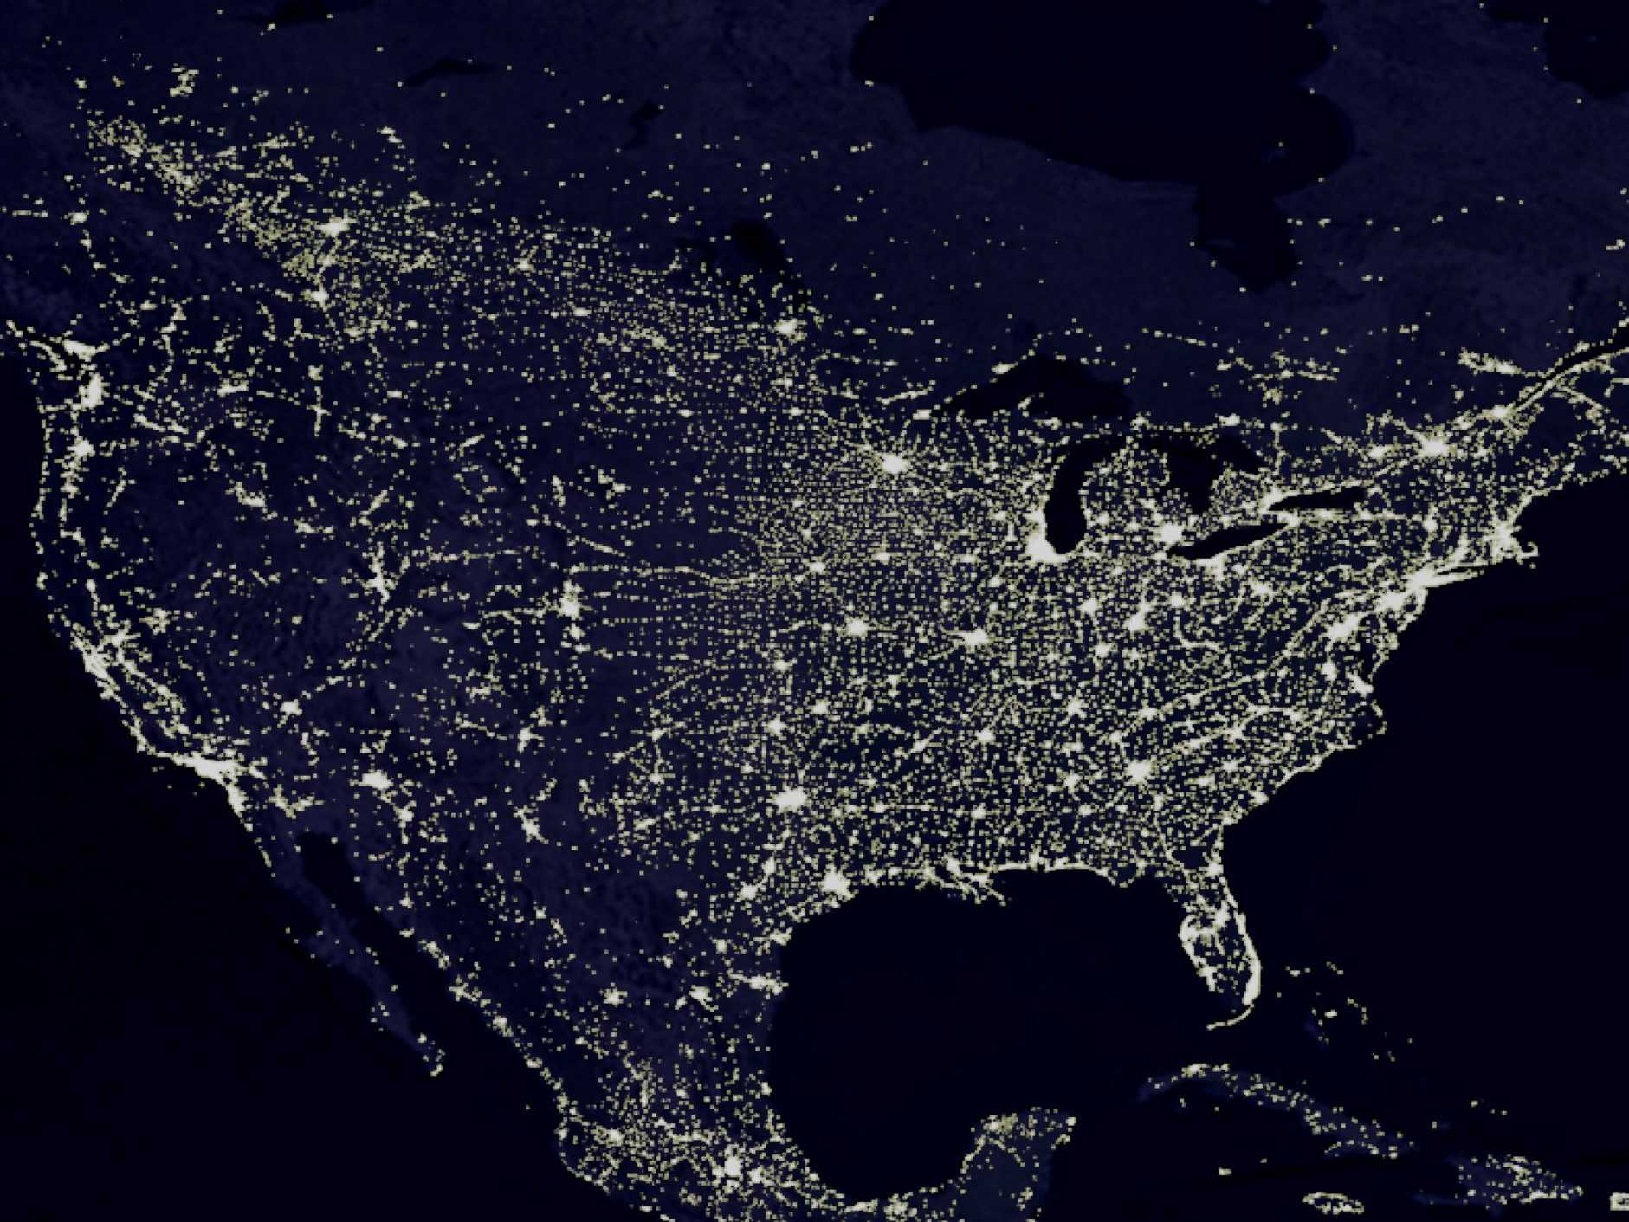

Where can we find networks?
EVERYWHERE!
Social networks
Friendships
Colleagues
Facebook/WhatsApp
Man-made networks
Transportation networks
Electricity network
Internet
Natural networks
Neural network
Gene – protein networks
Food webs

Slide 5
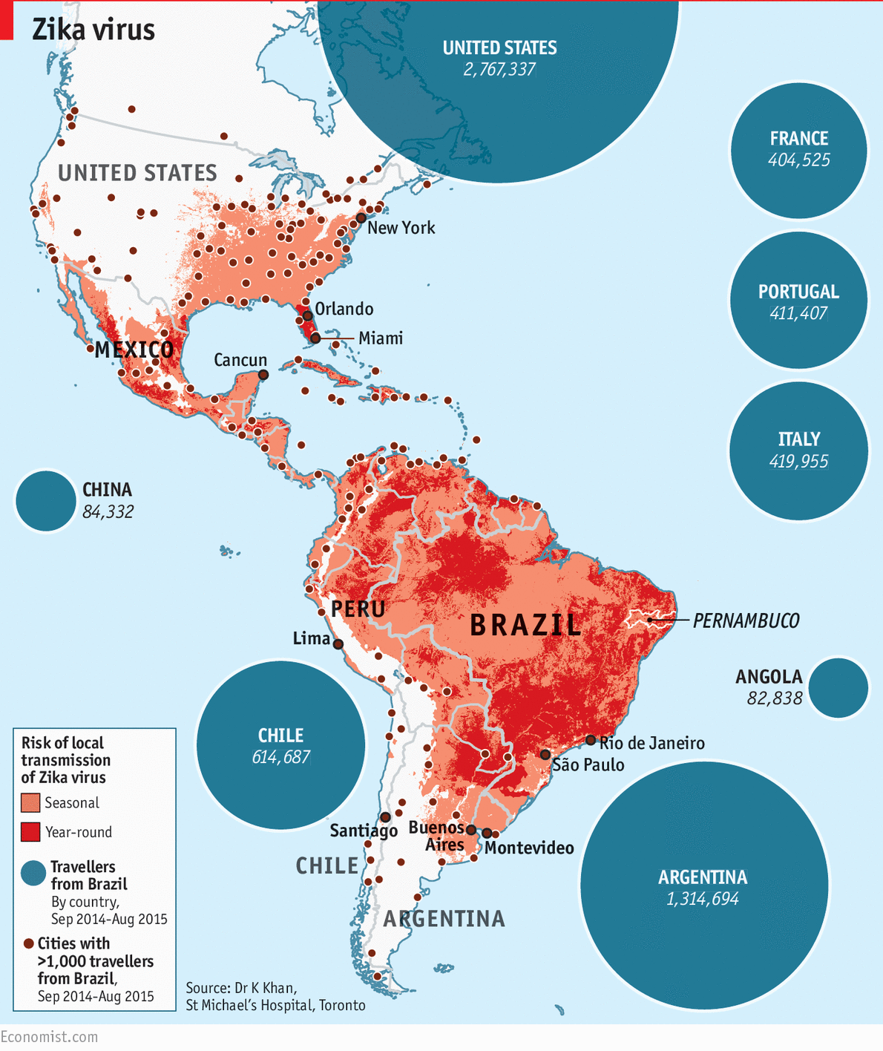
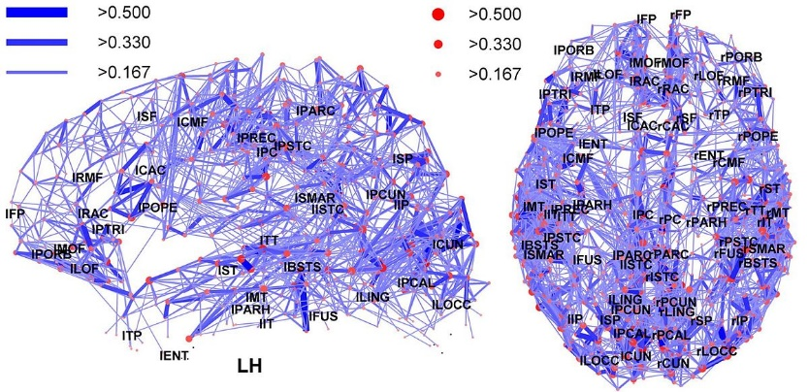
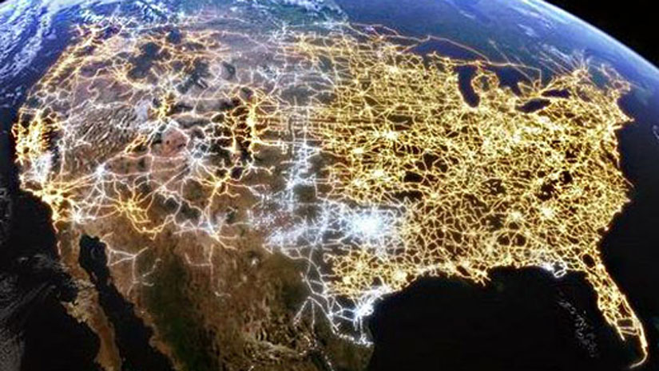
Why are networks important?
Help understanding complex systems
Cellular metabolic networks
Neural networks
Ecosystems
Several networks are vulnerable duo to their interconnectivity
Electrical systems
Transportation
Internet
Understanding social trends
Spread of diseases
Marketing purposes
Trade networks

Slide 6

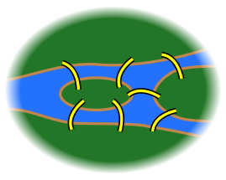
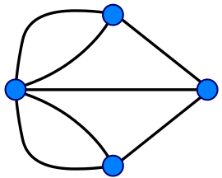
The Seven Bridges of Königsberg
Two large islands connected to each other, and to the two mainland portions of the city, by seven bridges
Walk through the city that would cross each of those bridges once and only once
Leonhard Euler reformulated the problem to graph theory
The number of times one enters a non-terminal vertex equals the number of times one leaves it
Except for the ones chosen for the start and finish), the number of bridges touching that land mass must be even
All four of the land masses in the original problem are touched by an odd number of bridges – NO SOLUTION

Slide 7
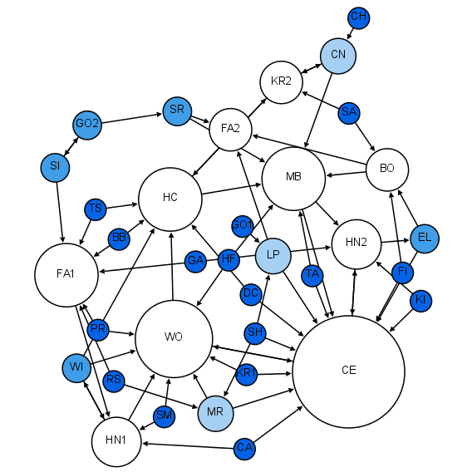

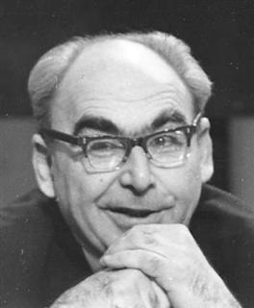

Network science – History
1735 – Leonhard Euler graph theory
Königsberg bridges
1933 – Jacob Moreno’s sociogram
1959 – a paper by Paul Erdős and Alfréd Rényi on random networks
1999 – a paper by Albert-László Barabási and Reka Albert in Science on scale-free networks – Network science becomes a discipline
Notes:
The city of Königsberg in Prussia (now Kaliningrad, Russia) was set on both sides of the Pregel River, and included two large islands which were connected to each other, or to the two mainland portions of the city, by seven bridges. The problem was to devise a walk through the city that would cross each of those bridges once and only once.
By way of specifying the logical task unambiguously, solutions involving either
reaching an island or mainland bank other than via one of the bridges, or
accessing any bridge without crossing to its other end
are explicitly unacceptable.

Slide 8
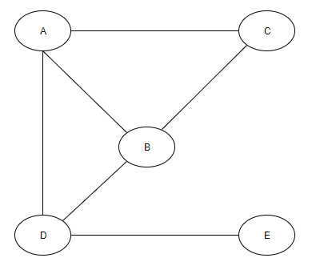
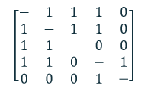
Matrices, graphs, and measures
Networks can be represented as matrices = adjacency matrix
Or as graphs

Slide 9
Network properties
Static or dynamic
Directed or undirected
Weighted or not weighted
Size (diameter, number of nodes)
Node and edge property distributions
Link density (Potential vs realized links)
Modularity
Cliques
Motifs
Percolation
Individual node or link properties

Slide 10
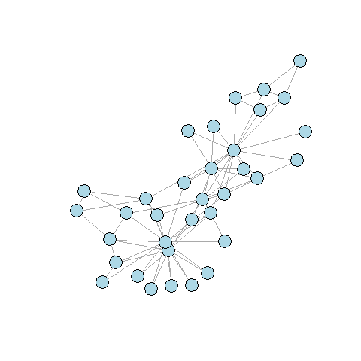
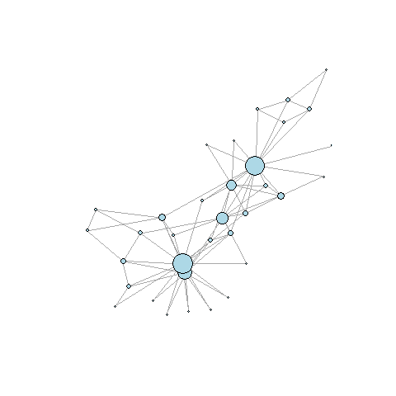

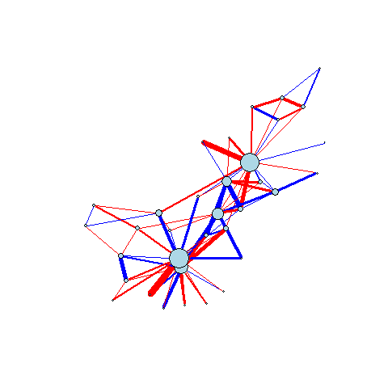
Node and edge measures
Nodes
Degree
Centrality
Betweenness (centrality)
Closeness (centrality)
Eigenvector centrality
Edges
Weights, strength of the connection
Strong connections
Weak connections stabilize networks
Directions
Path length
Hubs

Slide 11
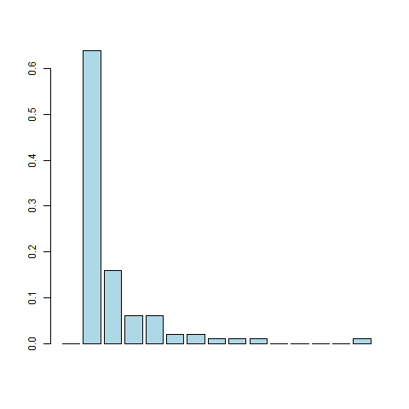
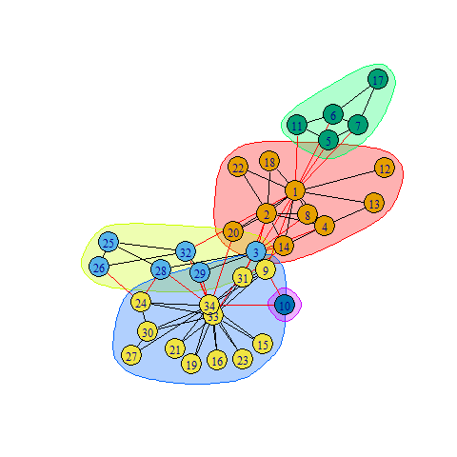
Network measures
Degree distributions
Average path length
Diameter (Size)
Average betweennes
Connectance
Clusters, cliques, motifs
Percolation

Slide 12
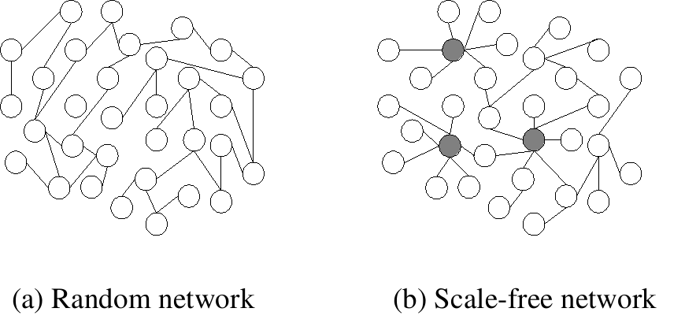
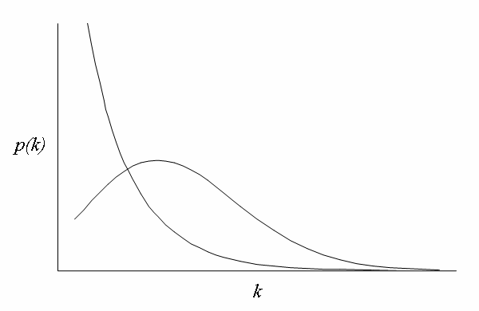
Random graphs and scale-free networks
In scale-free networks
Continuous growth of the number of nodes
Random networks assume a fixed number of nodes
The degree of the largest hub rises polynomially with the size of the network
In random networks this rises logaritmically
The degree of a hub can be high in a scale-free network, whilst it will be small even in a very large random network
Preferential attachment – a new node has a tendency to link to a node with a higher degree,
Power-law distribution – most of the nodes with few links to others, and few nodes with a high number of links
Shortening the path lengths in a network
Resilient to random, but vulnerable to targeted attacks – hubs are vulnerable
Rapid spread of information/diseases/perturbances

Slide 13
Small-world networks
Most nodes can be reached from every other node by a small number of steps
Six degrees of separation
The concept was originally set out in a 1929 short story by Frigyes Karinthy
A chain of "friend of a friend“ – “six handshake distance”
First described in social networks
Stanley Milgram’s small-world experiment – finding the average path length between two random nodes
Erdős number
Characteristic of non-random networks with preferential linking
“The rich gets richer”
True for ecological networks as well

Slide 14
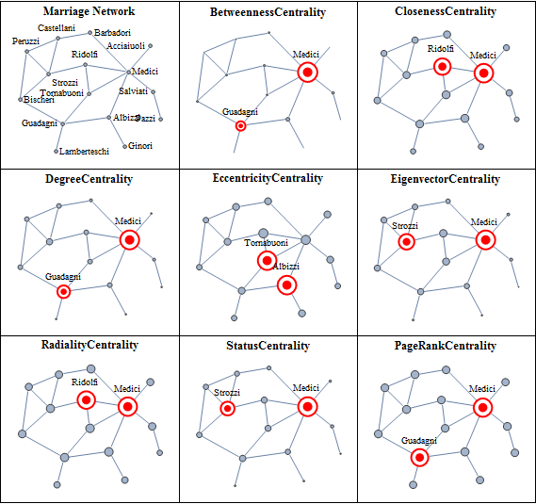
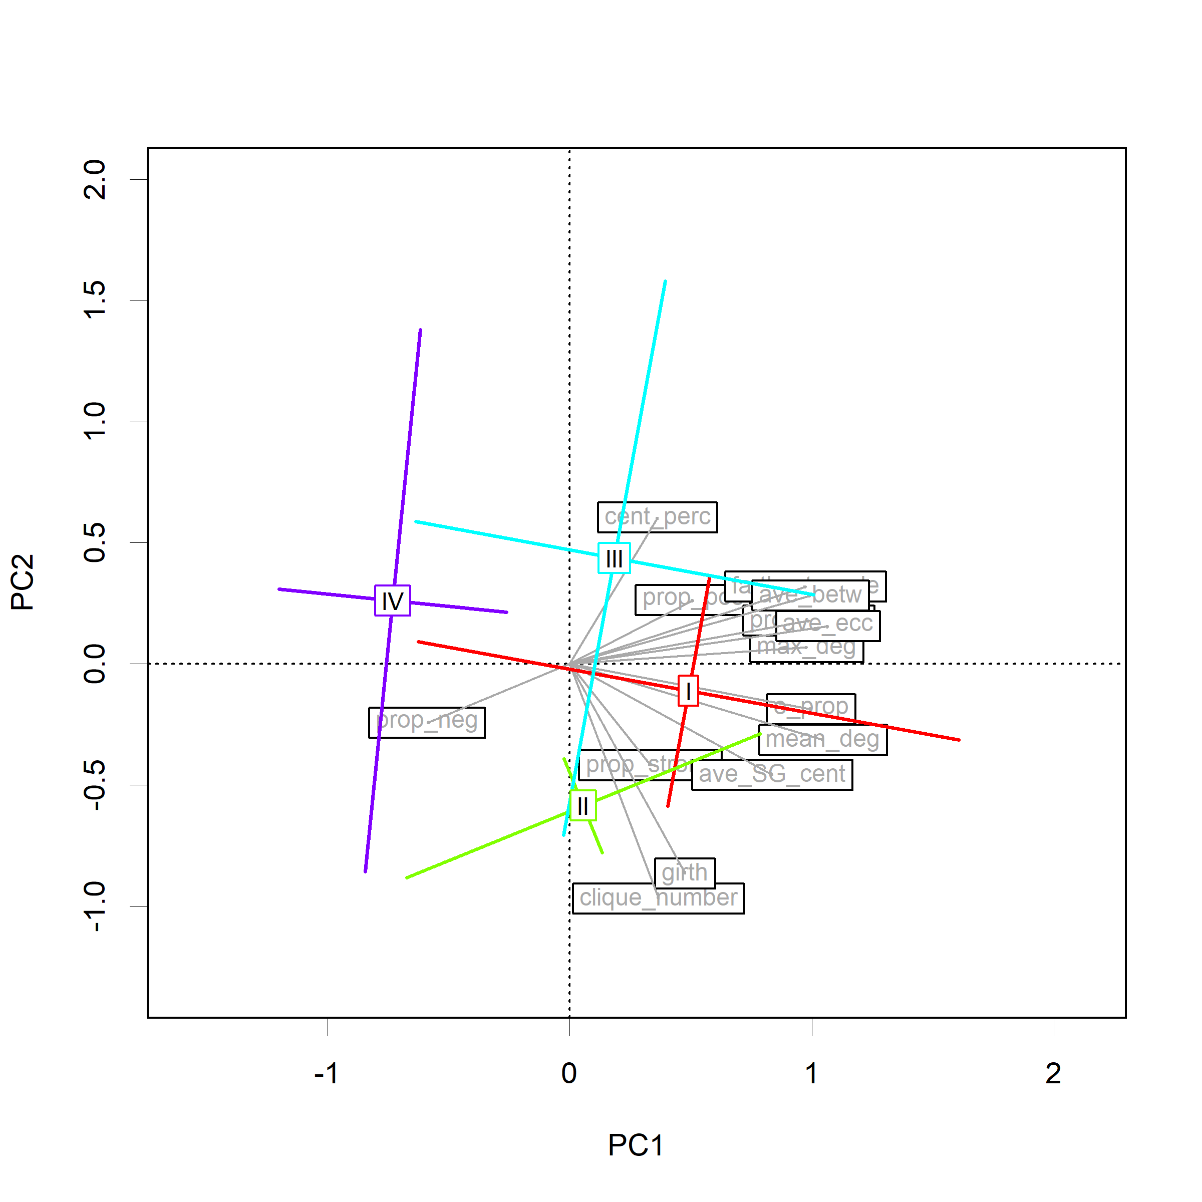
Comparing networks
Multivariate methods
Null models

Slide 15
Directedness, small-world, and scale-free
Food webs and symbiotic networks are directed
Co-occurrence networks are rarely directed, since the ecological interactions forming links are unknown
Energy-flow-based networks (mostly food webs) are small world – path length is only a few steps
Energy loss
Loops can be present (e.g. cannibalism) but rarely recorded
Scale-freeness and whether they follow power law distribution is debated

Slide 16
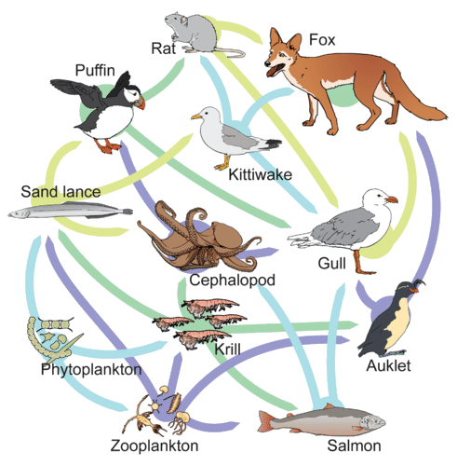
Networks in ecology
“An ecological network is a representation of the biotic interactions in an ecosystem, in which species (nodes) are connected by pairwise interactions (links).”
Food webs – links are trophic
Plant – herbivore interactions
Predator – prey interactions
Host – parasitoid interactions
Mutualistic relationships – links are symbiotic
Plant – pollinator networks
Tree mycorrhiza networks
Competition networks – very rarely considered
Others:
Metapopulations
Island biogeography – fragmentation research

Slide 17
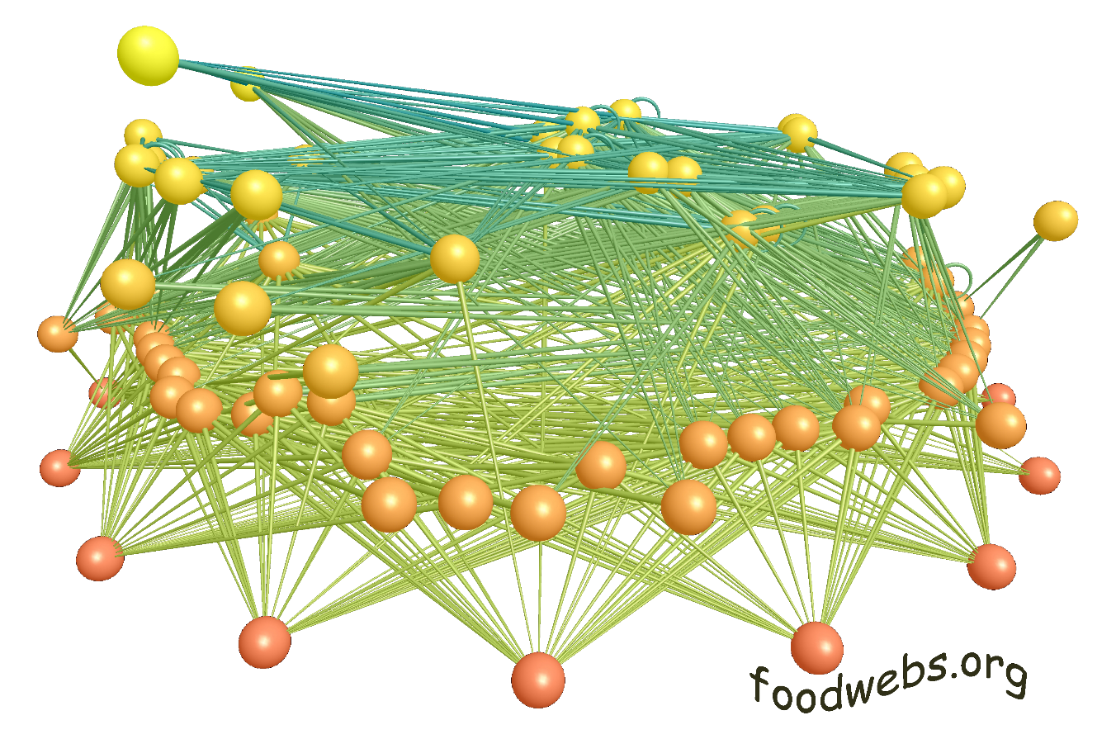
Studying ecological networks
Due to their complexity it is rather difficult
Started with simple food webs
Modern molecular techniques
Next generation sequencing
Environmental DNA
Modern statistical methods
Big data
Bayesian networks
Artificial intelligence (AI)
These new methods have to be tested
Ecological interpretation is often difficult

Slide 18
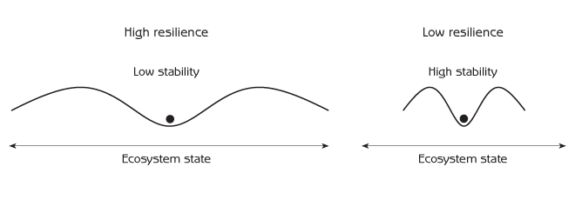
Stability and resilience of ecological networks
Definitions
Stability: the network’s ability to return it’s original stage after perturbance
Species loss
Invasion
Resilience: the ability to absorb disturbances
It is of high conservation concern
The delivery of ecosystem services (ES) depends on the integrity of the ecological networks in an ecosystem
Removing elements of the network can cause catastrophic events
“Rewiring” the network
The network falling apart
Changed ecosystem, with most likely decreased ESs

Slide 19
Complexity and stability
Complexity is a product of the number of species and connectance
Complexity leads to stability in food webs because of redundant links
Theory says therefore that increasing species number leads to increased stability
Not all real-life networks support
Link strength may be an influential factor
Interaction strength may decrease with the number of links between species, decreasing the effect of disturbance
Increased compartmentalisation increases stability

Slide 20
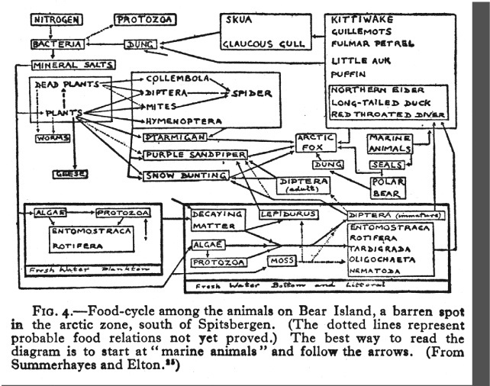
Food webs
"All animals, in short, cannot exist without food, neither can the hunting animal escape being hunted in his turn.“ Al-Jahiz, 9th century
Darwin used "entangled bank", "web of life", "web of complex relations"
Summerhayes and Elton (1923) – Herring food web
“food chain” – “food web”
Paine (1988) – Qualitative food webs

Slide 21
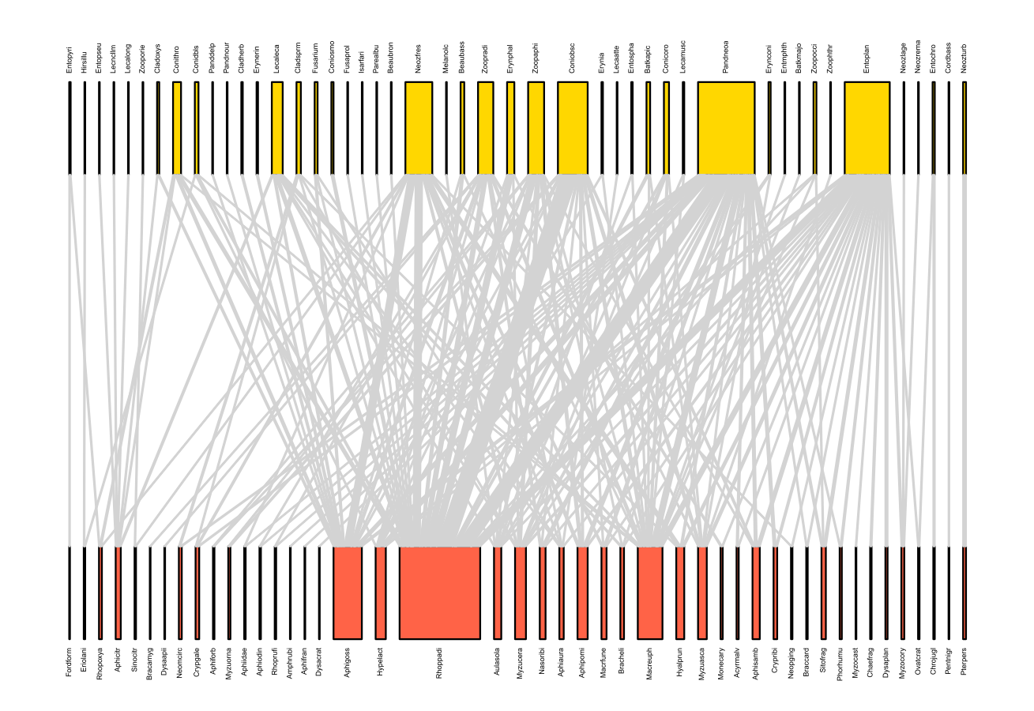
Bipartite networks
Between two groups
Plant-pollinator, host-parasite, predator-prey
Network measures can be calculated but differently than those to non-bipartite networks
Nestedness is an important property
Projected networks can be informative

Slide 22

Co-occurrence network
Interactions are difficult to map
Species interactions can be predicted based on species co-occurrences
Co-occurrence can happen because of similar niche requirements or dispersal limitations
If two species do not co-occur then interactions are not possible
Variety of methods
BNs use discretized abundance data to map interaction network
Correlations
HMSC
Permutational processes calculate probabilities
Interaction strengths can be estimated
Network properties can be calculated
They do not represent real interactions but ‘associations’

Slide 23
Pros and cons of co-occurrence networks
PRO
Easy to discover
Issues the method suffers from are common in ecology – including traditional interaction detections
Facilitative/competitive interactions
Otherwise rarely studied
Improving statistical approaches
HMSC
CON
Overlap with food webs seems to be of particularly low
Predators and prey do not co-occur in small scale but they do at a large scale
May also depend on population dynamics/cycles
Multiple or indirect interactions may also play a role
Asymmetry of associations between species can blur co-occurrence signal
Some links are not easy to interpret ecologically

Slide 24
Other ecological networks
Patches of habitats (protected areas, islands, lakes) linked with dispersing species, or migrating populations/individuals
Population genetics (alleles linked with gene transfer)
Individuals in social animals’ societies (individuals linked with social interactions)
Species providing the same ecosystem services (linked with the same service, but they may provide slightly different functions)

Slide 25
Network properties in ecology
Node and edge numbers (size and diameter)
Degree distribution: the degree distribution of an ecological network is the cumulative distribution for the number of links each species has.
Display the same universal functional form.
Two component parts: species' prey (in-degree) and links to a species' predators (out-degree).
In a food web species have more in-links than out-links
Keystone (hub) species with high degree (many links)
Complexity (linkage density): the average number of links per species.
Connectance: the proportion of possible links between species that are realized
Related to the statistical distribution of the links per species. The distribution of links changes from (partial) power-law to exponential to uniform as the level of connectance increases.
The observed values of connectance in empirical food webs appear to be accountable for by constraints on an organisms diet breadth driven by optimal foraging behaviour. This links the structure of these ecological networks to the behaviour of individual organisms.

Slide 26
Clusters and compartments
Clustering: the proportion of species that are directly linked to a focal (keystone or hub) species
Large effects on the network if a hub species is lost .
Compartmentalization: the division of the network into relatively independent sub-networks.
Some ecological networks have been observed to be compartmentalized by body size and by spatial location.
Compartmentalization in food webs is a result from patterns of species' diet choices
Important in how quickly disturbance effect spreads
Motifs – are sub-graphs of n-nodes found embedded in a network
Food webs have particular motif structures

Slide 27
Nestedness
Nestedness: the degree to which species with few links have a sub-set of the links of other species, rather than a different set of links.
“A pattern of interaction in which specialists interact with species that form perfect subsets of the species with which generalists interact."
In highly nested networks, guilds of species that share an ecological niche contain both generalists (species with many links) and specialists (species with few links, all shared with the generalists)
Several measures to calculate
The level of nestedness is determined not by species features but overall network depictors (e.g. network size and connectance)
Reciprocal relationship to modularity – mutualistic and competitive interactions in ecological networks

Slide 28
Node properties
Degree of nodes is important in food webs
Ratio of negative and positive links is important (vulnerability)
Betweennes can be particularly important in spreading diseases or providing ecosystem services
A lot of measures each show slightly different things
Assortativity – preferential linking (e.g. food preference)

Slide 29
Node properties – non-directed graphs
Node/ Measure | Deg | Betw | Close | Eigen
A | 3 | 2/6 | 5/4 | 8
B | 3 | 2/6 | 5/4 | 8
C | 2 | 0 | 7/4 | 6
D | 3 | 3/6 | 5/4 | 7
E | 1 | 0 | 8/4 | 3

Slide 30
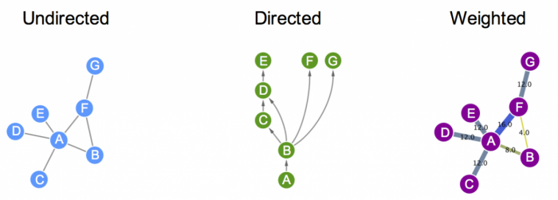
Edge properties
Directed or undirected
Weights can be given to edges
Interaction probability – Important for co-occurrence networks
Trophic-level data
Size data
Literature data
Interaction strength
Frequency of co-occurrence/visitation
Abundance
Energy flow
Path length is NOT physical length and it is not strictly an edge property

Slide 31
Important notes
The measure of link density depends on the networks
S² – all connections (including loops) = 25
S(S-1) – all connections (directed) = 20
S(S-1)/2 – all connections (undirected) = 10
S₁xS₂ – bipartite connections (only between two groups) = 6
Several measures strongly correlate with node number
Measures can correlate with each other as well
The ecological usefulness of several measures are not clear

Slide 32
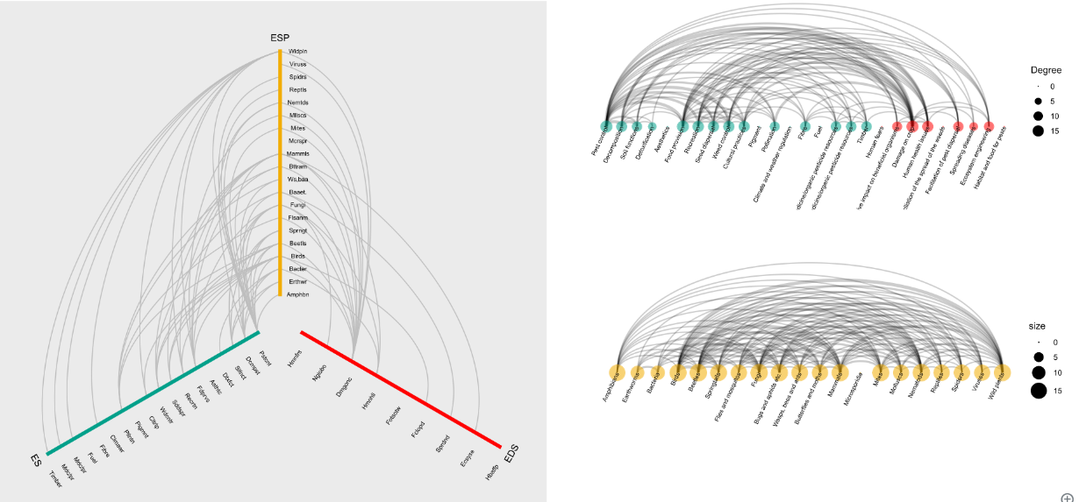

Projected (side) networks
Directly connect nodes on one side of a bipartite network based on common neighbouring nodes
Can be weighted by the number of common nodes (mostly species, but e.g. ecosystem services provided as well)
Can detect competition, intraguild predation or any other indirect interactions between species

Slide 33

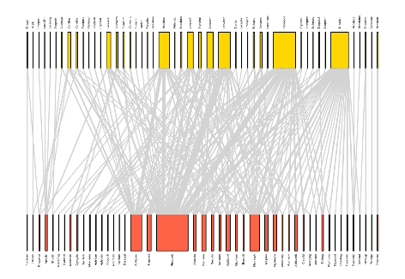
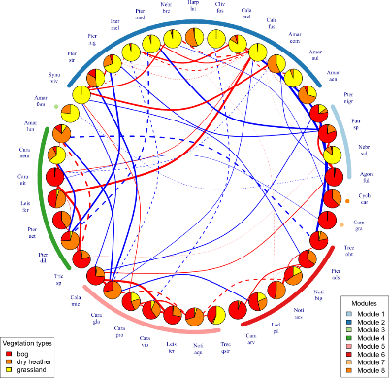
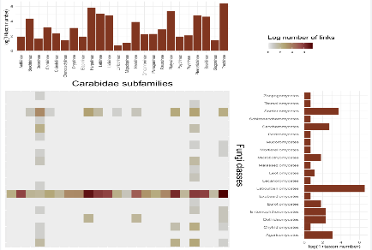
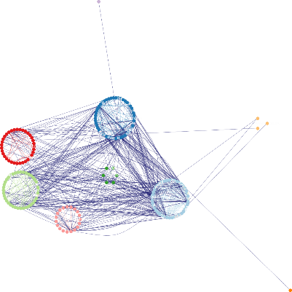
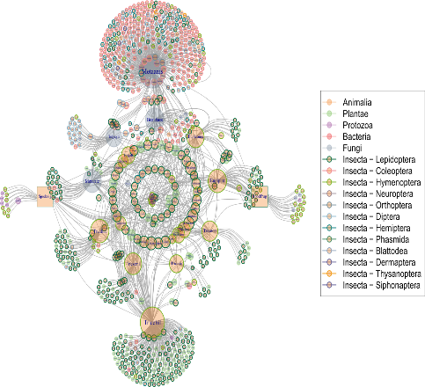
Graphical representations
Heatmaps
“Fuzzy” network graphs with a variety of layouts
Circular graphs
Grouped networks
Hive plots
Node sizes, shapes, and colours can be changed
Edge line type and thickness can be changed

Slide 34
Databases and future focus
GloBi
Mangal
Conservation of interactions
Interaction networks in biogeography
Individual-based networks
Below-ground networks
Multi-layer networks
Automatized interaction recordings

Slide 35
Analysing ecological networks
Python
igraph
R – several packages
igraph
bipartite
visNetworks
network
Gephi
Cytoscape

Slide 36
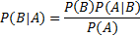
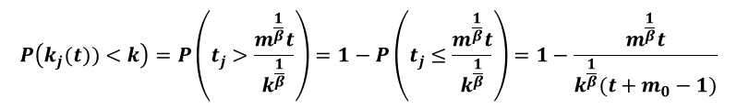
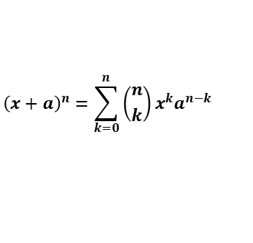
AND… The most important mathematics behind
$${\left(x+a\right)}^{n}=\sum_{k=0}^{n}{\left({n \atop k}\right)x^{k}a^{n−k}}$$
P(k) ~k⁻³
Thank you for the attention!
P(k) ~ k^{-γ}
$$P\left(k_{j}(t))<k\right)=P\left(t_{j}>\frac{m^{\frac{1}{β}}t}{k^{\frac{1}{β}}}\right)=1−P\left(t_{j}≤\frac{m^{\frac{1}{β}}t}{k^{\frac{1}{β}}}\right)=1−\frac{m^{\frac{1}{β}}t}{k^{\frac{1}{β}}(t+m_{0}−1)}$$

